Slide 1
My Flat Shapes, Angles and Lines Interactive Notebook
Name
Class
Term 3 Semester 2

Slide 2
Contents
Formula Page
Page
Date
Description
2
3

Slide 3
Tasks
24
7
30
Essential Question
Questions
Notes
Summary
10
11

Slide 4
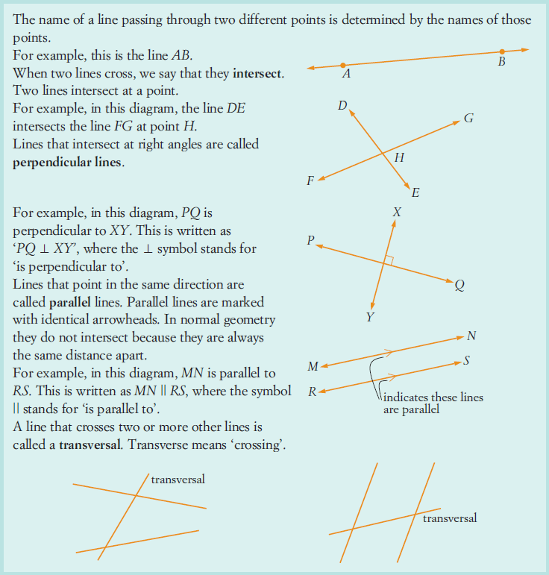
24
7
30
Date
Angle Relationships
First - revision of lines etc
11

Slide 5
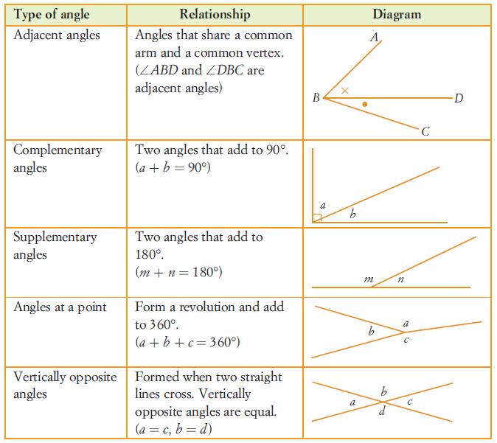
24
7
30
Date
Angle Relationships
EQ – How do I describe angles according to their relationship to each other?
Angles alongside each other
11

Slide 6
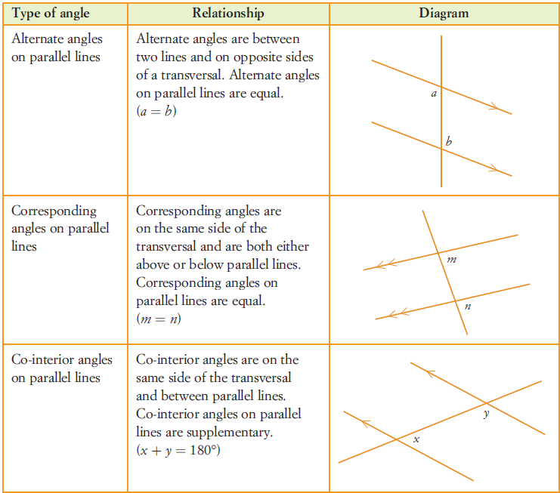
24
7
30
Date
Angle Relationships
EQ – How do I describe angles according to their relationship to each other?
Angles in parallel lines
11

Slide 7
24
7
30
Date
Angle Relationships
EQ – How do I describe angles according to their relationship to each other?
Start on exercise 3.2 page 117 – 126 of your text book.
11

Slide 8
Notes Review
24, 7 ,30
Date
Title
Essential question
Notes complete
Notes complete with colour and diagrams
Questions completed
Contents page filed in
Formula page filled in

Slide 9
Homework
Review your notes and write a summary answering the essential question.

